Slide 1

Countries of the world
Ali Ibrahim Alyahya

Slide 2



What is the project all about
A website that takes you around the world and sees picturesque tourist and heritage sites, helping to choose the right destination

Slide 3
project requirement
Home Page, Favorite Page, Content page
Display the countries names and images
Simple and modern layout
Search Functionality

Slide 4
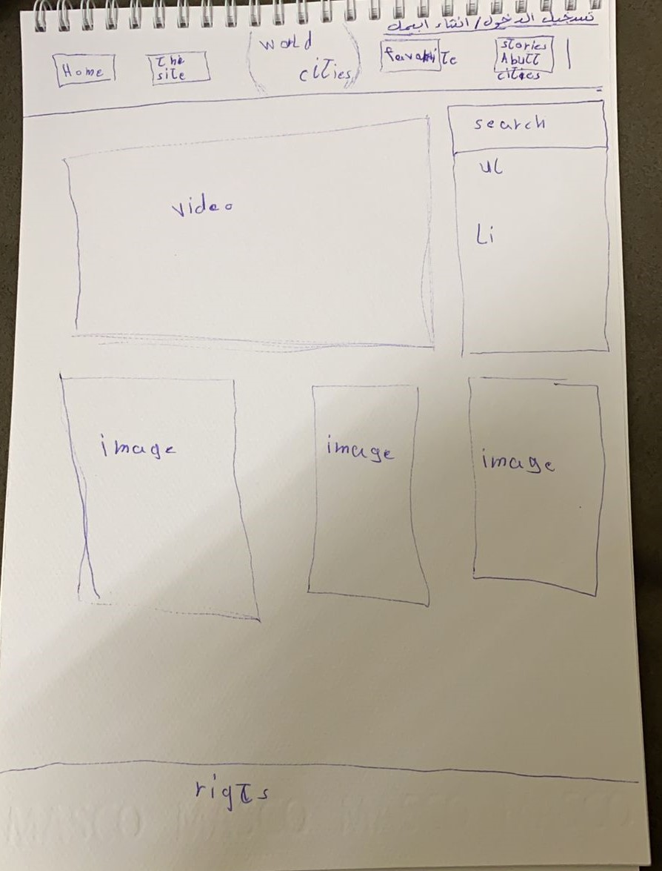
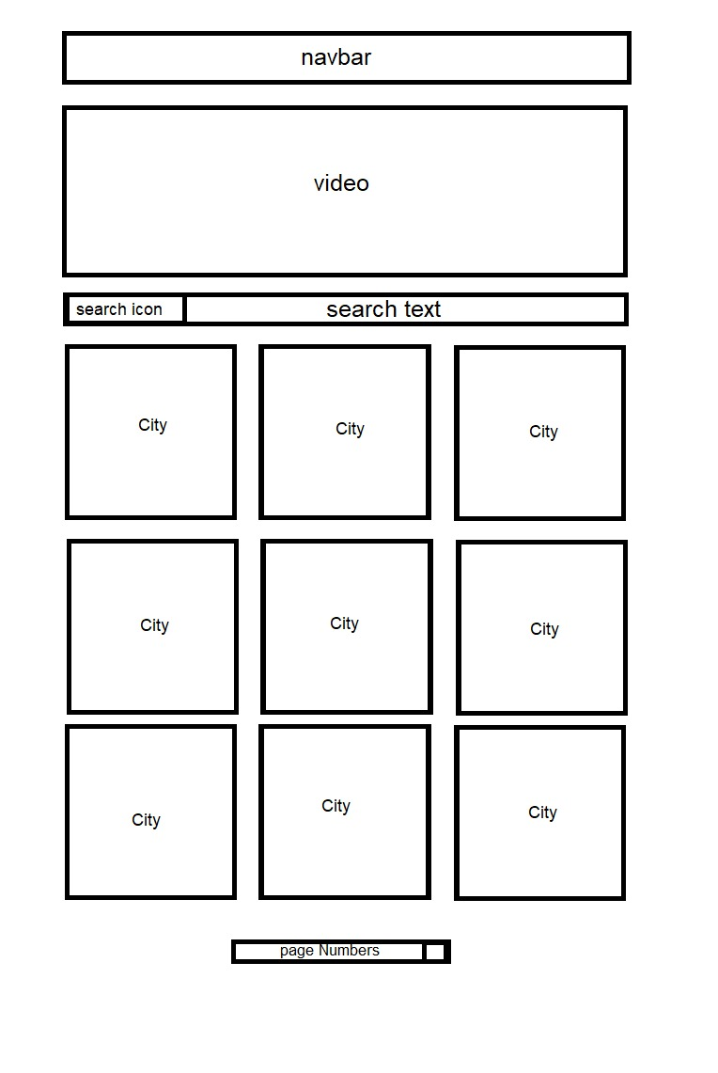
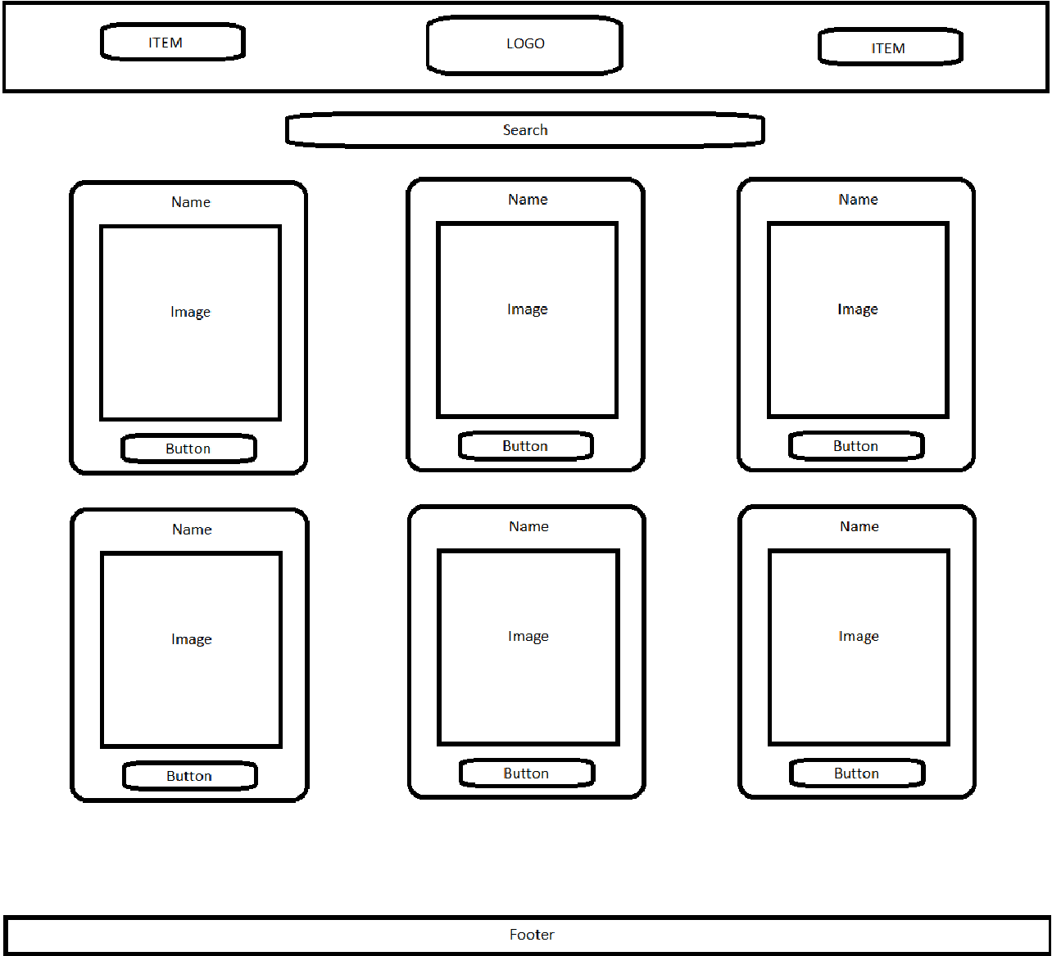
Design the project

Slide 5



Used technologies
HTML5
CSS3
JavaScript

Slide 6




Used TOOLS
VS code
Chrome
GitHub
Photoshop

Slide 7
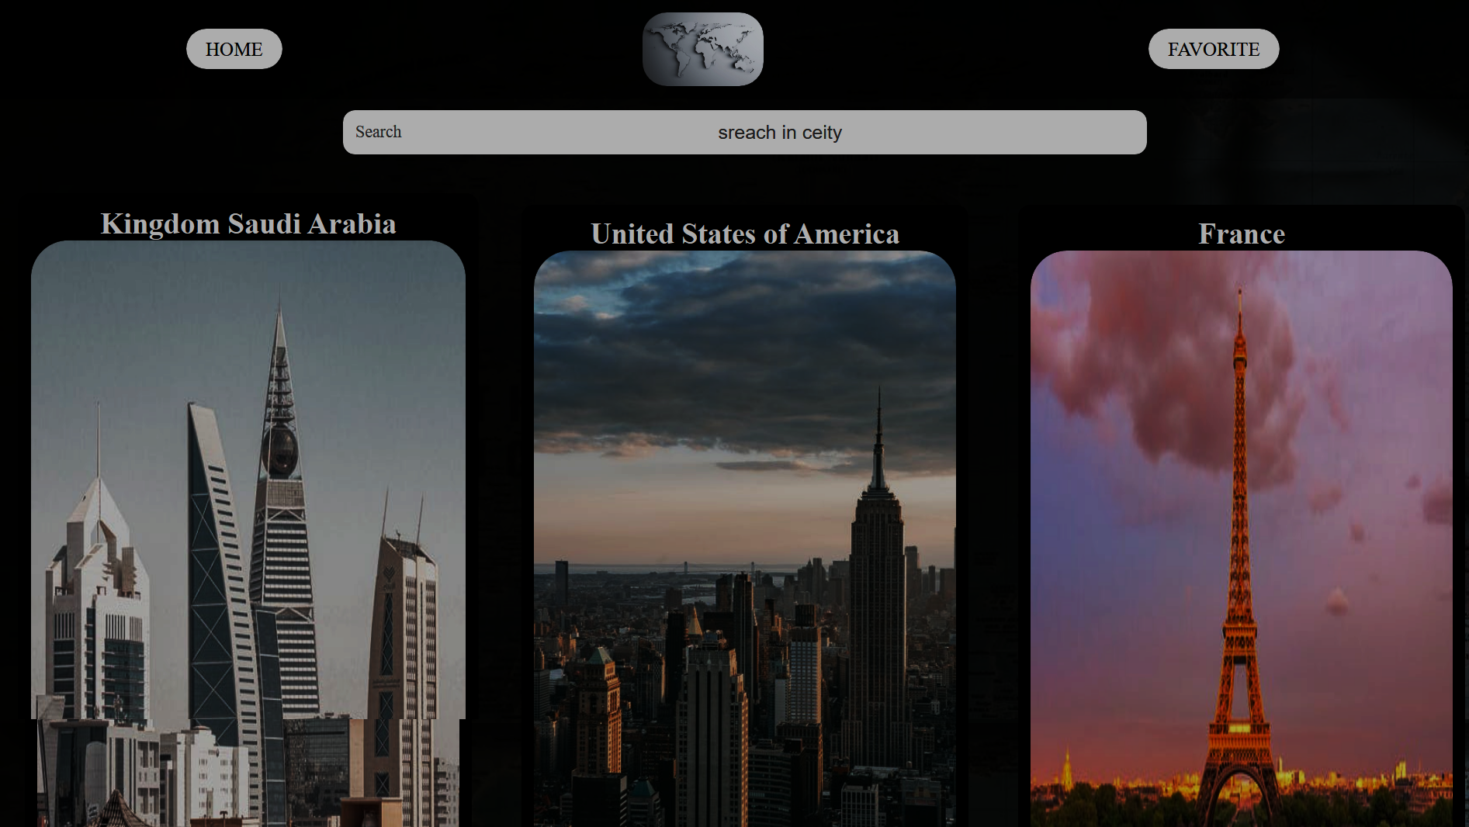
Demo

Slide 8

THANK YOU

